Slide 1
Crime Data Analysis
IE 6200 | Prof. Dehghani | Noah Klur, Jordan Lian

Slide 2
Project Goals
To determine which city has the highest crime rates overall
To determine if crime rates were correlated to average income.
To determine which city had the highest crime rate per capita

Slide 3
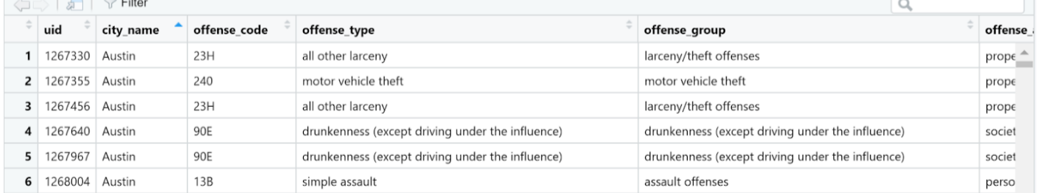
Data Collection
Used crime data from the crimedata library in R, get_crime_data()
Cities represent a sample size, the United States is the overall population
uid | city_name | offense_code | offense_type | offense_group
offense_against | date_single | longitude | latitude | location_type
location_categories | census_block | start_date | end_date

Slide 4
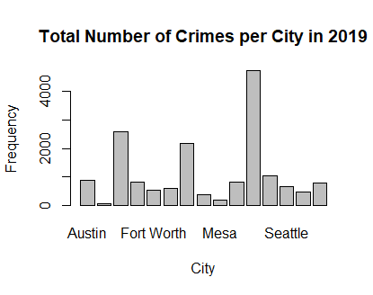
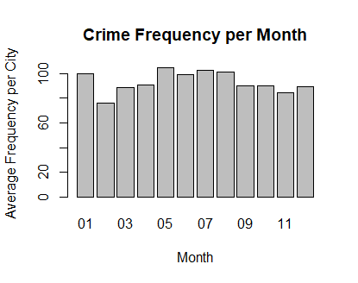
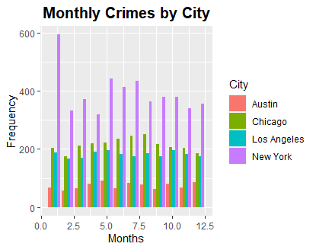
Data Visualization

Slide 5
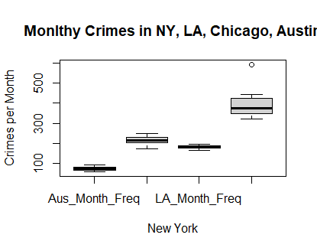
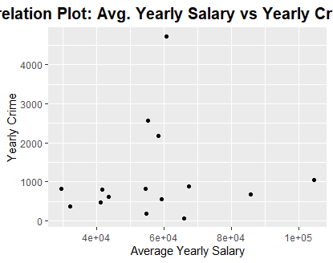
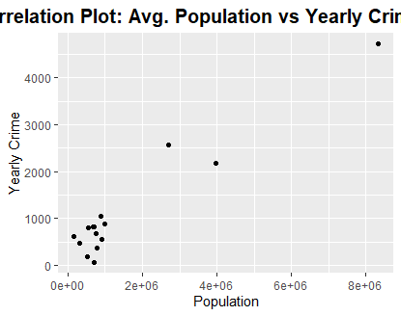
Data Visualization, continued

Slide 6
Statistical Analysis
Hypothesis Test of Unequal Variances for New York and Austin
Rejected Null Hypothesis H₀: σ² < σ₀², σ₀² = 73.02411 for New York
95% Confidence Interval for the Variance of New York
5,223.567 < σ² < 5662.627
Probability Sampling Distribution of Means
P(X > 95) = 0.7356, X: RV, crimes per month
Failed to Reject the Null Hypothesis H₀: σ² < σ₀², σ₀² = 73.02411 for Austin

Slide 7
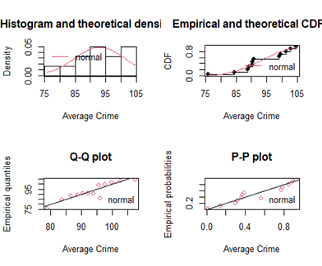
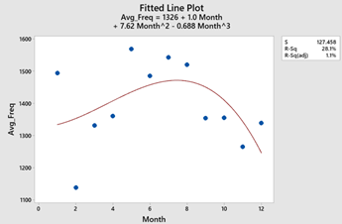
Advanced Analytics
Regression Analysis: Minitab and R

Slide 8

Audience Q&A Session
ⓘ Start presenting to display the audience questions on this slide.

Slide 9

Thank You!
Scan for Feedback/Questions

